Slide 1

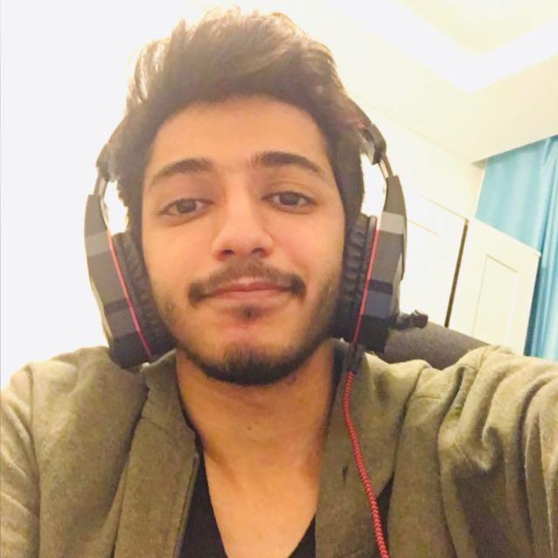
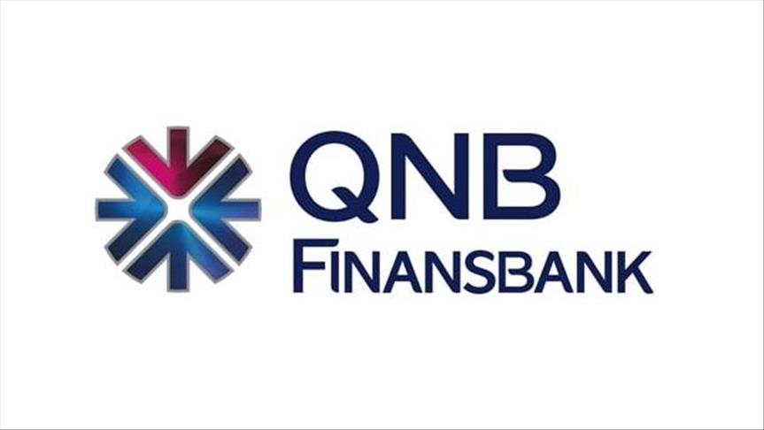
Yousef Elbayoumi 1722326

Slide 2

Table of Contents:
Introductory Information
Comparisons, Provided Services, and more details
Financial Reports
Personal Opinion
References

Slide 3
Introductory Information
1

Slide 4

Ziraat Bank was officially established on 15 August 1888 as a modern financial institution.
The number of branches increased from 110 to 300 in 1923, and in 1963 the number reached to 630.
Ziraat bank had an active role in the war period.

Slide 5

Ziraat Bank’s sole shareholder is Turkey Wealth Fund, which is owned by the government.
Ziraat bank shareholders:
T.C. Ziraat Bankası, Ankara, Republic of Turkey: 100%
Ziraat Bank Headquarter(HQ): The Bank has its head office located in Ankara.

Slide 6

Chief Executive Officer (CEO): Ahmet Cemal Yıldırım.
President of the Board of Directors:
Battal ARSLAN.
President of the Audit Committee:
Cüneyt SAĞLIK.

Slide 7

As of 31 December 2020, the Bank has 1,728 domestic branches.
Ziraat Bank has a wide foreign service network in 17 countries.
112 service points including 24 foreign branches and 9 international subsidiary banks.​​​

Slide 8

As of 31 December 2020, the Bank has 24,673 employees.​​
Designation of the form of the company: Shareholders company.
Head office: Ulica slobode br. 84, 81 000 Podgorica

Slide 9

Ziraat's vision is to provide products and services at universal standards.
to be a prestigious and dependable financial institution with high market value.
to offer the quality of being more than a bank at every stage.

Slide 10

QNB Finansbank is a Turkish bank with headquarters in Levent, Istanbul.
It was established by leading Turkish banker Hüsnü Özyeğin in 1987.
for a period was the Turkish bank with the largest network of foreign branches.

Slide 11
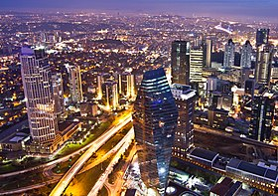
QNB Finansbank Tower in Levent, Istanbul (originally named Soyak Crystal Tower).
As of September 30, 2015, the bank operated with 647 branches and 13,000 employees (QNB).
In 2016 the QNB Group headquartered in Doha, Qatar acquired Finansbank.

Slide 12
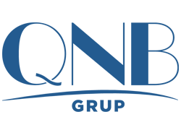
QNB was founded on 6 June 1964 as the country's first domestically-owned commercial bank.
Was initially headquartered in a government-owned building in Qatar's capital city, Doha.
It had 35 employees in its first year.

Slide 13

Chief Executive Officer (CEO): Temel Güzeloğlu.
Chairman of the Board:
Ömer A. Aras.
Chairman of the Audit Committee:
Ali Teoman Kerman.

Slide 14

Being the architect of all individual and commercial financial plans that will catalyze Turkey’s success.
Establish a lifelong partnership with stakeholders by understanding their needs.
finding right solutions and aiming for maximum customer satisfaction.

Slide 15

As of 2021 March 31, total number of branches are 525, and number of employees are 12,087 (QNB Finansbank).
Finansbank A.Ş is the first private bank that went public.
The Bank's name has been changed to QNB Finansbank in October 2016.

Slide 16
Comparisons, Provided Services, and more details
2

Slide 17

Similarities in the target group:
people who have bank accounts.
Businesses may use it to set up their account and so they can easily take money out of their business.
Working people may use it as they may not have time to go to the bank and take out money.

Slide 18

Differences in the target group:
Ziraat Bank targets to timely satisfy all financial needs of its customers.
Based on an understanding, Ziraat always puts customers in its focal point.
QNB Finansbank managed to become “a bank within a bank” by identifying a new target group among banking customers whose needs were not met previously.

Slide 19
Brand positioning:
Basic quality
Quality
High quality
Untrustworthy
Credibility
Trustworthy
Few choices
Accessibility
Many choices
Limited
Spread
Widespread
Not understanding the customer
Customer Advocacy
understanding the customer

Slide 20
Brand positioning continue:
Not advising
Smart Money
Counseling
Low thrift
Thrift
High thrift
Fake
The Antidote
Honest
Low integrity
Integrity
High integrity
Low value
Overall Value
High value

Slide 21
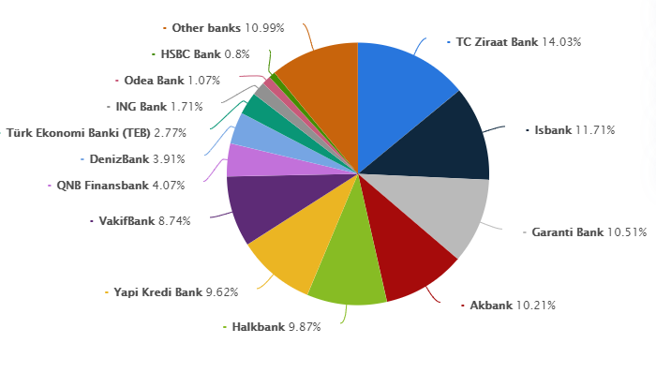
Market shares:
General market share for the top banks in Turkey, was published in 2017.
TC Ziraat Bank: 14.03%
QNB Finansbank: 4.07%

Slide 22
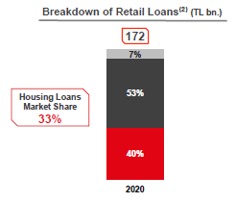
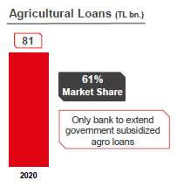
Market shares continue:
Largest ATM network:
7,274 ATMs 13.8% market share
Ziraat Bank:
Increase in market share of credit card balance:
From 3.3% in 2016 to 7.1% in 2020

Slide 23
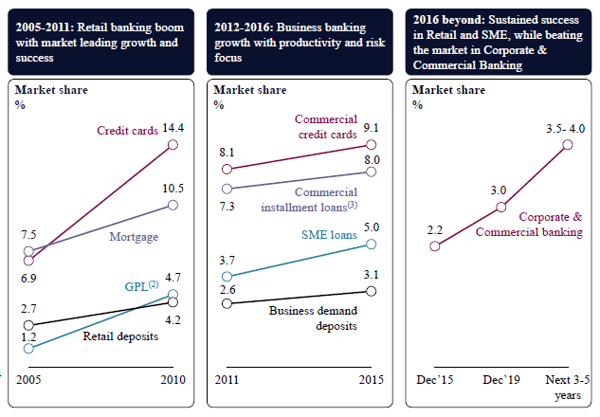
Market shares continue:
QNB Finansbank

Slide 24

Product portfolios:
Ziraat Bank Services:
1. Privilege Rental Service Package
A package offers many advantages for both tenants and landlords, many banking services with advantageous conditions benefits.
2. Foreign Exchange Transfer (SWIFT)
Offering a guaranteed foreign transfers with the Ziraat Guarantee, and foreign transfers may be made at any one of Ziraat branches using SWIFT or Western Union.

Slide 25
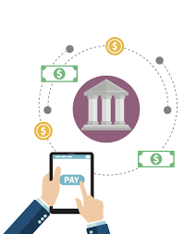
Product portfolios continue:
3. Western Union
Fast and secure money transfer all over the world.
Sending/Receiving money via Western Union in Ziraat mobile and internet banking.
Sending/Receiving money (Transfer) via/by Western Union in branches.
4. DCC (Dynamic Currency Conversion)
Payment solution that allows foreign card holders from different countries of the world to make payments in their local currency.

Slide 26

Product portfolios continue:
QNB Finansbank Services:
1. Your Special Customer Relations Manager
He will assist you and provide you with all information you need about bank transactions, developments, and expectations in the market.
2. QNB First Service Line Special for You
From now on, whenever you call the call center, you will be greeted and assisted by a special assistant.

Slide 27

Product portfolios continue:
3. High ATM Withdrawal Limit and Free Transactions from other Banks’ ATMs
You will enjoy the comfort of drawing cash up to TRY 5,000 daily from QNB Finansbank ATMs.
4. Safe Deposit Box Discount
30% discount on annual safe deposit box rentals.
50% discount on deposit fees.
Note: these discounts are for the QNB first family.
5. Buying and Selling Stock Shares via FinansInvest

Slide 28

Product portfolios continue:
6. Cash Transfer Service
You can have your cash savings transferred to QNB Finansbank from other banks in the company of bulletproof, armored vehicles and private security.
7. Buying and Selling Stock Shares via FinansInvest

Slide 29

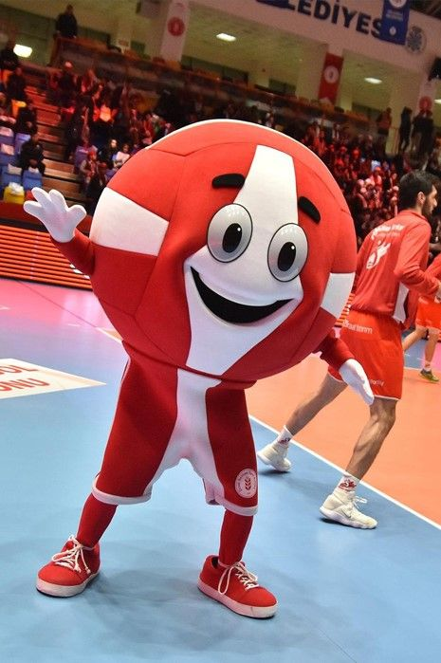
Logos, Slogans, and Mascots:
Ziraat Bank:
Slogans:
2013 Slogan: “Together Towards the Goal”
2015 Slogan: “Together, to a Better Future”
2020 Slogan: “More for Turkey from agriculture to energy”
Official Logo
Mascot?

Slide 30

Logos, Slogans, and Mascots continue:
QNB Finansbank:
Slogans:
“Everyone needs a financier”
Official Logo
No Mascot founded

Slide 31

Expansion, Development, and Distribution
Ziraat Bank:
2014:
2015:
Ziraat Mobile
IOS and Android app
Ziraat Onay
Security app providing approval to access internet banking through Ziraat Mobile
Mobile branch
App for devices not compatible with IOS and Android
Flexible limits
Transaction limits defined specifically to a segment or a customer
Ziraat Tablet IOS Android
E-Devlet Integration
Product Applications through channels

Slide 32

Expansion, Development, and Distribution continue:
2016:
New Corporate Internet Branch
Ziraat Mobile For Corporate Clients
OmniChannel Experience
Standardization of interface and transaction flows
Interaction between channels
2017:
Money withdrawal by using QR code
Enhancing mobile transactions
Multiple language mobile branch
New Data Center

Slide 33


Expansion, Development, and Distribution continue:
2018:
POS Platform
Bankkart: (Website, Mobile, POS Website)
Corporate Website
Ziraat Assistant
2019:
New Banking Software
New Mobile Branch
Internet and Mobile Branch Assistant
Loan access through Internet and Mobile Branch
2020:
Robotic Automation Processes
ChatBot
Web Based New Banking Software
Digital Ecosystem Integration
Data Analysis Excellence Center

Slide 34
Expansion, Development, and Distribution continue:
QNB Finansbank:
Direct Sales
Mobile Banking
708 in-house personnel
2.8 mn active mobile banking customers
Internet Banking
525 Branches
427K active internet banking customers
Covering 71 out of 81 cities of Turkey
Call Center
Telesales
928 inbound agents
50 outbound agents

Slide 35

Expansion, Development, and Distribution continue:
Field Service
Mobile Banking
1.25 mn active mobile banking customers
235 field service personnel
Internet Banking
ATMs
215K active internet banking customers
2941 ATMs around Turkey and reaches ~7718 ATMs through new ATM sharing program
Call Center
POS
294 inbound agents
245K POS terminals

Slide 36

SWOT Analysis:
Ziraat Bank:
Strengths:
Weaknesses:
Ziraat Bank is the strongest bank in Turkey in terms of product, service and distribution network diversity
Ziraat Bank is considered bad in terms of treating the customer, you can hear something in branch, and you will hear different story in the other branch
Opportunities:
Threats:
Ziraat Bank is already the most popular bank in Turkey so the next plan should be opening in other countries
Ziraat Bank is the government’s bank, this brings good things to the bank, but at the same time it’s exposed to some threats because of it

Slide 37
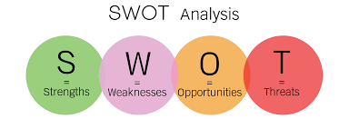
SWOT Analysis continue:
QNB Finansbank:
Strengths:
Weaknesses:
One of largest banks in terms of total assets
Strong presence in Tukey and Middle East
Has its offices and presence in over 15 countries
Not much presence in southern parts of Africa, America, and Europe
Slow down in deposit growth affecting the bank’s operations
Opportunities:
Decrease in foreign investments in Turkey and Middle East affecting the bank
Dependency on foreign banks for funds and loans is a major threat in the current uncertain global markets
Threats:
High opportunity to expand in other African countries through acquisitions
Demand for bond market in Turkey and Middle East will propel bank’s growth
Growth in Islamic banking will help in bank’s growth

Slide 38

Innovations:
Ziraat Bank:
Kolay Adres İle IBAN’sız Para Transferi Başladı
İnternet ve Mobil Bankacılığa Online Başvuru
Güvenli Ödeme Sistemi
İnternet Bankacılığı’ na Girişin Yeni Yolu: T.C. Kimlik Kartı
FAST
Note: it’s written in Turkish because the English translation doesn’t make sense.

Slide 39

Innovations continue:
6. ATM Avuç İçi Tanıma Sistemi
7. Ziraat Tablet
8. Ziraat Mobil Kurumsal
9. QR Kod ile Para Çekme ve Para Yatırma
Note: it’s written in Turkish because the English translation doesn’t make sense.

Slide 40

Innovations continue:
QNB Finansbank:
SWIFT GPI
What is SWIFT GPI?
QNB Finansbank integrated into the SWIFT GPI (Global Payments Innovation) system.
You will be able to easily and step by step follow your foreign currency transfers made through our bank or received by our bank.
Foreign currency transfers that you could not trace before became faster and more transparent.

Slide 41

Awards:
Both Ziraat Bank and QNB Finansbank have a great and many awards and going over them is endless
I will put their links in the recourses. However, we are here to talk about special award
Ziraat Bank has won the award of “The most loved bank” provided by MediaCat for 5 consecutive years!
(2016 – 2020)

Slide 42




Promotional Activities:

Slide 43
Social media accounts:
Ziraat Bank:
QNB Finansbank:
Joined 1 Oct 2012
16.2K subscribers
1 video last 24 hours
3 videos last 1 week
10 videos last 1 month
Total views: 81,315,062
Total videos: 129
Joined 24 Aug 2006
59.6K subscribers
0 video last 24 hours
1 videos last 1 week
6 videos last 1 month
Total views: 262,477,333
Total videos: 473
Joined Nov 2010
453,600 followers
1 tweet last 24 hours
5 tweets last 1 week
Total tweets: 4,768
Active page
Joined Mar 2010
109,600 followers
1 tweet last 24 hours
3 tweets last 1 week
Total tweets: 11,600
Active page

Slide 44
Social media accounts continue:
Ziraat Bank:
QNB Finansbank:
Page liked by 2,319,920
Page followed by 2,342,346
2 post 24 hours
5 posts last 1 week
Active page
Page liked by 363,180
Page followed by 362,884
1 post 24 hours
3 posts last 1 week
Active page
Joined 29 Aug 2014
208K followers
2 post last 24 hours
5 posts last 1 week
Total posts: 1099
Active page
Joined 28 Aug 2013
46.3K followers
1 post last 24 hours
3 posts last 1 week
Total posts: 823
Active page

Slide 45

Sponsorships:
Ziraat Bank:
Ziraat Bank sponsored Bolu Abant İzzet Baysal Üniversitesi (BAİBÜ) with providing sponsorship support to the university in scientific, social, cultural, and sports events.
Ziraat Bank became the main sponsor of Zeljeznicar club.
Ziraat Bank sponsored many fairs opened in Turkey and abroad in 2017.
Ziraat Bank sponsored the Turkish Cup for 7 years since the 2007-2008 season.

Slide 46

Sponsorships continue:
QNB Finansbank:
Sports Sponsorships:
Art Sponsorships:
QNB Finansbank Istanbul Seniors Cup
QNB Finansbank Doctors Cup
Istanbul Champions Cup
Fenerbahce Basketball Sports Club
Trabzonspor Sports Club
Jihad Burak Book
Abidin Dino Book
Book of Alev Ebüzziya
Nejad Revolution Book
The Book of Mübin Orhon
Canan Tolon Book
Erol Akyavaş
Erzurum Photography Competition Atatürk University

Slide 47

Sponsorships continue:
Education Sponsorships
Sponsorship for Sectors
QNB Finansbank supports the "Gala Modern", which is organized every year in order to create opportunities for the education of children and young people.
QNB Finansbank is the supporter of "CardFinans", the 5th largest credit card brand in the sector, and the "Retail Days", the largest business organization in Turkey since 2001.
ÇEV Sanat Young Talents
QNB Finansbank "Young Talents" project provide financial support to meet the needs of our 42 talented young musicians in the field of music.

Slide 48

Discounts Campaigns:
Ziraat Bank:
Emeklinin Artısı Ziraat’te – Türk Telekom Kampanyası
Noter Çalışanları Ve Ailelerine Sigorta Ve Bireysel Emeklilik Kampanyası
TOKİ Konut/İşyeri Başvuruları Artık e-Devlet’te
Türkiye Hayat ve Emeklilik Kampanyası
Türkiye Sigorta Kampanyası
Note: it’s written in Turkish because the English translation doesn’t make sense.

Slide 49

Discounts Campaigns continue:
QNB Finansbank:
Otomatik Fatura Ödeme talimatı verin 100 TL PP kazanın!
QNB Finansbank Kolay Adres Iphone 12 Kampanyası
Note: it’s written in Turkish because the English translation doesn’t make sense.

Slide 50
Financial Reports
3

Slide 51
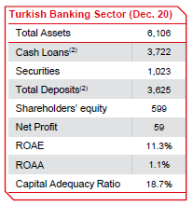
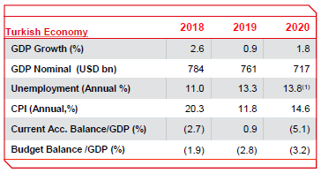
Some information about the Turkish economy

Slide 52
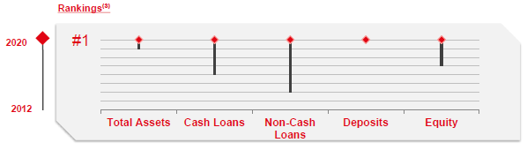
Ziraat Bank is the strongest bank in Turkey in terms of product, service and distribution network diversity.
Ziraat Bank:

Slide 53
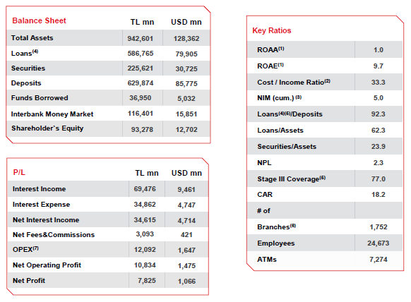
Financial Snapshot collected at the end of 2020 and beginning of 2021.

Slide 54
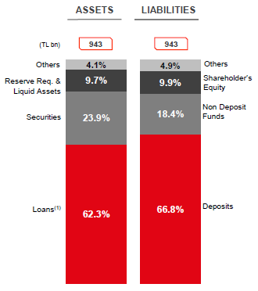
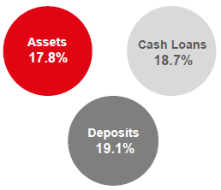
Details of Assets and Liabilities:
Market Penetration

Slide 55
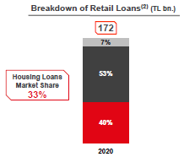
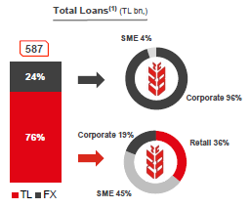
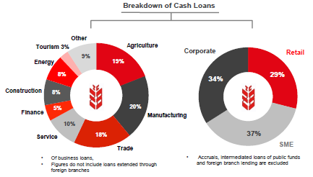
Financial reports for Lending

Slide 56
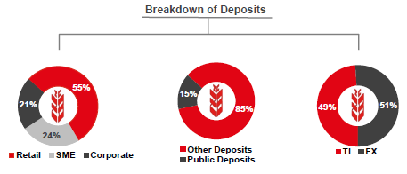
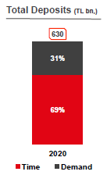
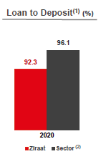
Financial reports for Funding

Slide 57
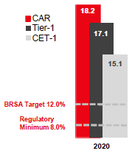
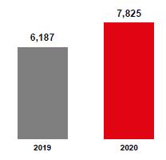
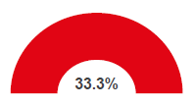
Financial reports for Profitability & Capitalization
Capital Ratios (%)
Net Profit (TL mn)
Cost/Income Ratio (%)

Slide 58
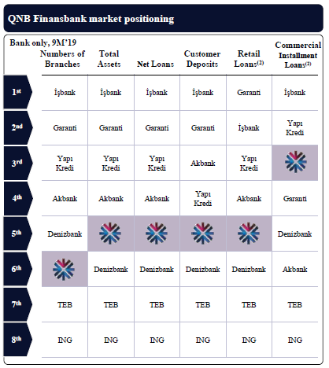
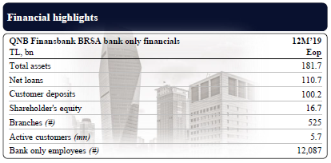
QNB Finansbank: 5th largest privately owned universal bank.
QNB Finansbank:

Slide 59
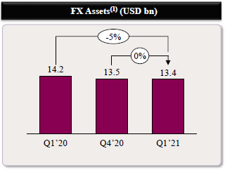
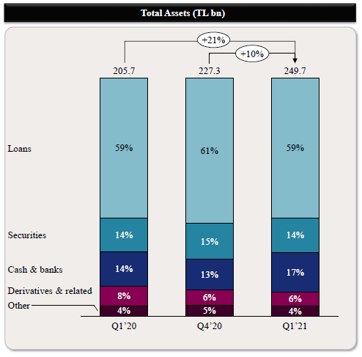
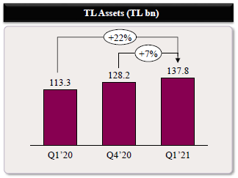
Asset base grew by 10% YtD, and loans reflected bank’s commitment to fund the economy

Slide 60
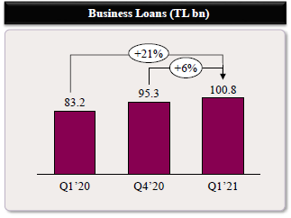
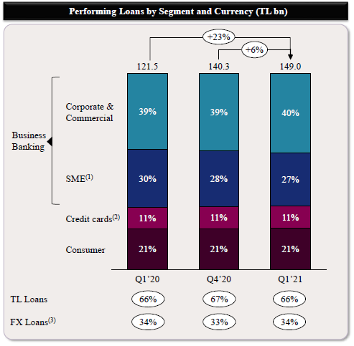
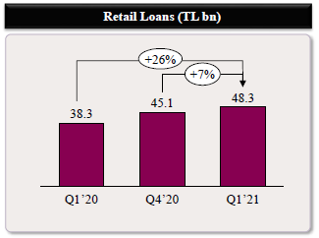
Loan growth of 6% QoQ, and equally supported by both Retail and Business segments

Slide 61
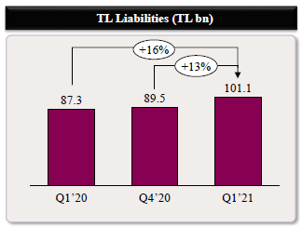
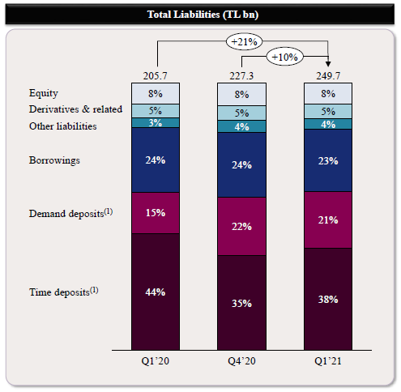
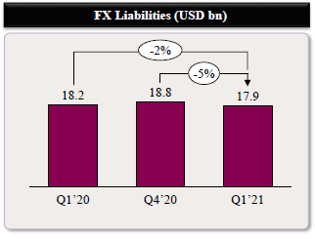
Details of the Liabilities:

Slide 62
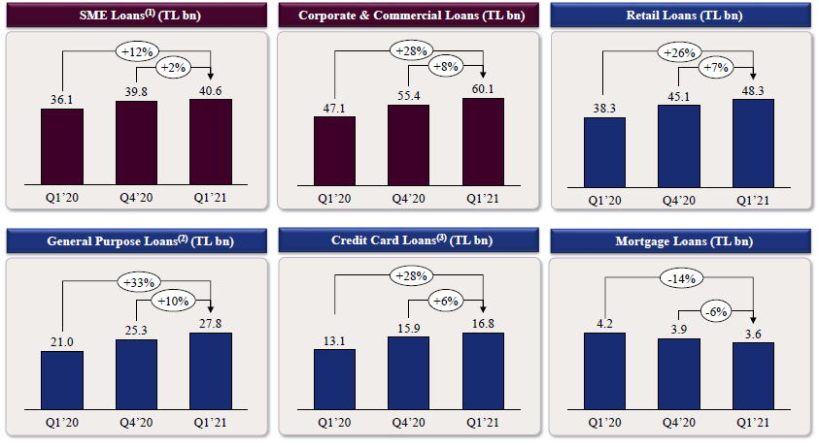
Business banking
Retail banking

Slide 63
Personal Opinion
4

Slide 64
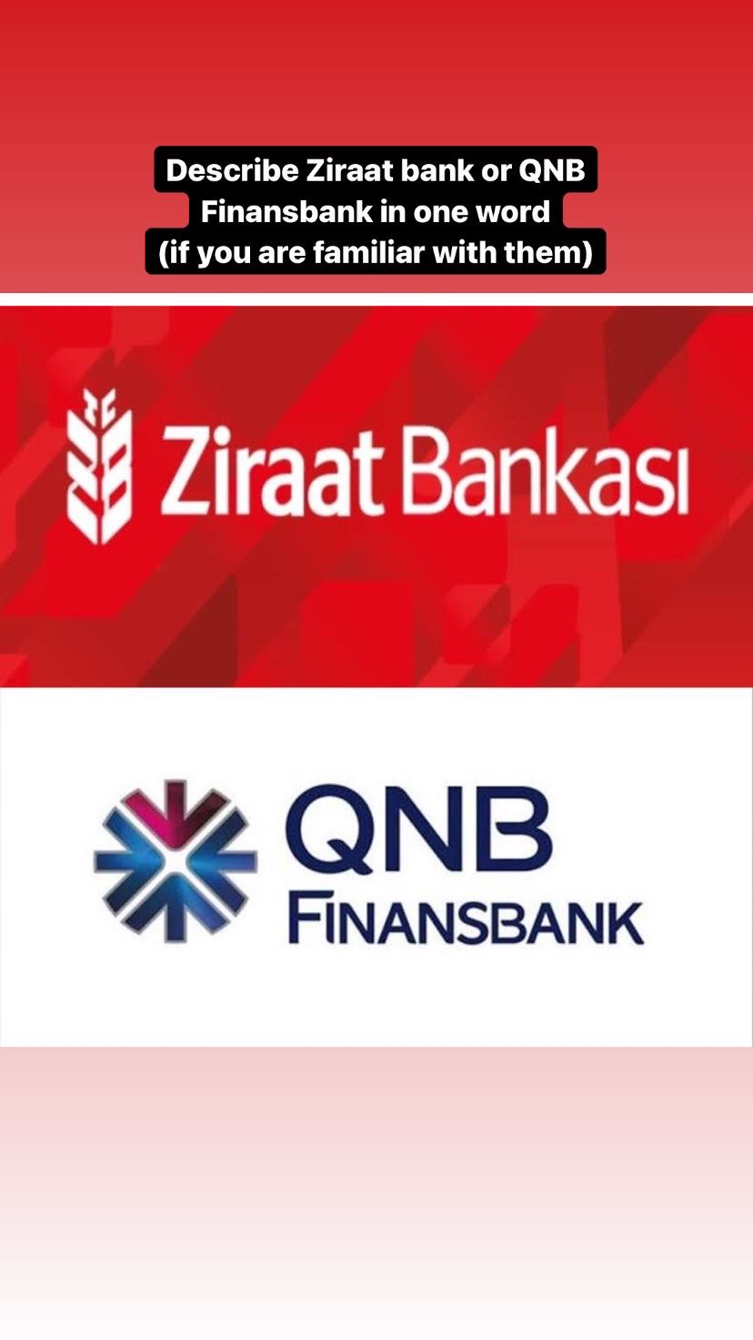
Before jumping to my opinion, I shared this to my Instagram account story..
I wanted to collect some opinions about these two banks from my friends
I wrote that I want “one word” but I will explain this trick in the next slide..

Slide 65

Out of The Topic:
When I asked for “one word”, I knew some people will try but they won’t be able to express themselves clearly, so they will write a sentence instead
If I asked for sentence from the beginning, people could feel bored from it and will just skip and go to the next Instagram story
This trick always work with me, I don’t mean to fool my friends but it’s in their human nature, a person does not like to be misunderstood

Slide 66

“Ziraat Bank is acting a little arrogant because it’s the government’s bank, Kadıköy branch will treat you differently than Beşiktaş branch.”
Some of My Friends Opinions:
“QNB Finansbank is better for you if you are a Turkish citizen”
“I feel my money will be safer with Ziraat bank”
“QNB Finansbank is refreshing like a cool breeze and it’s the most solid bank in Turkey”
“I tried both of them, and I can tell you İşbank is a better choice”

Slide 67

My Personal Opinion:
I believe each bank is distinct in something, so to conclude the whole picture:
I think that Ziraat Bank is distinguished by its services. On the other hand, I think that QNB Finansbank is characterized by good handling and understanding their clients.
I love both banks, but if I must open an account in only one of them, I will go with Ziraat Bank, I care more about the services and I don’t believe I will deal with the employees much

Slide 68
References
5

Slide 69
1. https://www.ziraatbank.me/tr (Ziraat official website page)
2. https://www.qnbfinansbank.com/
(QNB Finansbank official website page)
3. https://en.wikipedia.org/wiki/Main_Page
(Wikipedia, search for everything)
4. https://www.google.com.tr/
(Google, search for everything)
5. https://www.ziraatkatilim.com.tr/bizi-taniyin/odullerimiz
(Ziraat Bank Awards)
6. https://www.qnbfinansbank.com/qnb-finansbanki-taniyin/oduller
(QNB Finansbank Awards)
7. https://mediacat.com/mediacat-lovemarks-2020-tum-liste/
(MediaCat Turkey’s Lovemarkets list for 2020)

